Slide 1
Canvas
Lesson 5

Slide 2
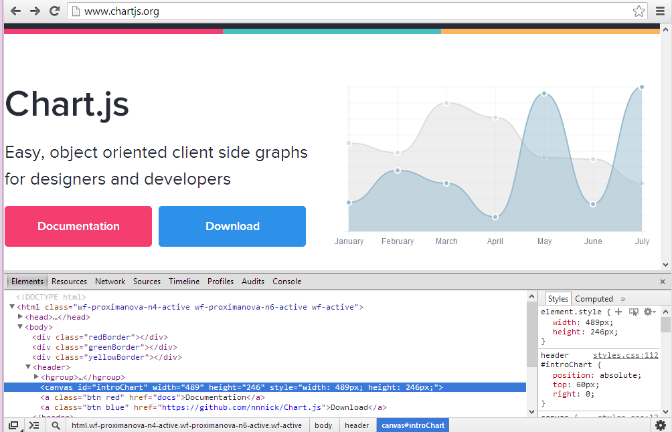
Graphics
http://www.chartjs.org/

Slide 3
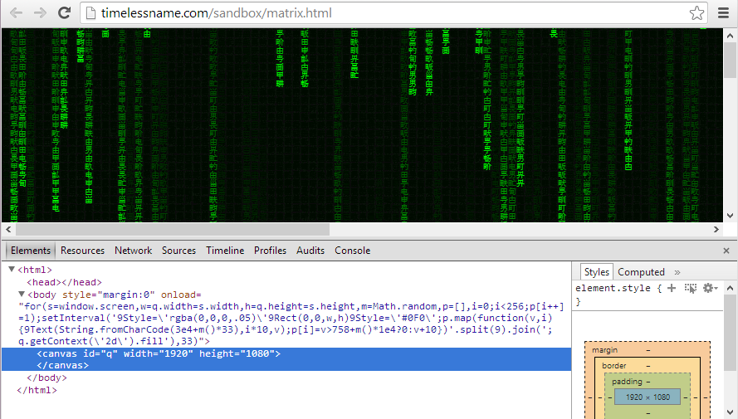
Animation
http://timelessname.com/sandbox/matrix.html

Slide 4
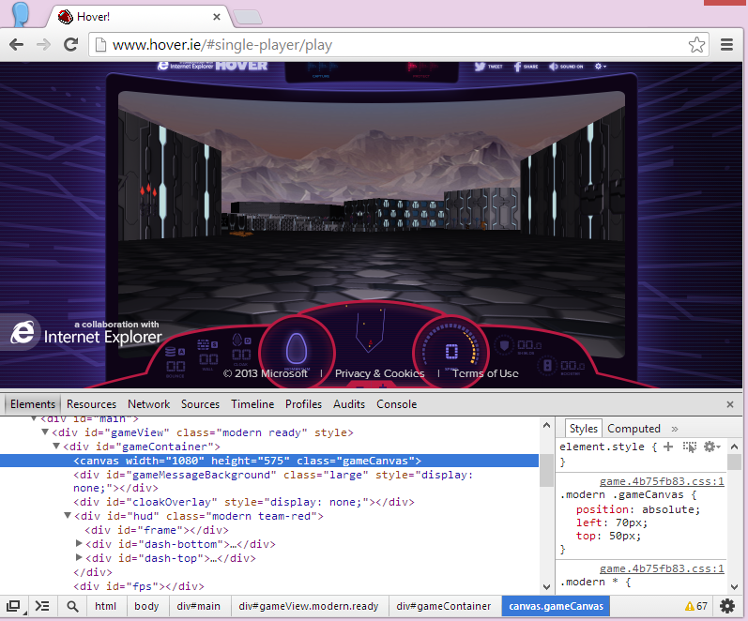
Games
http://hover.ie/

Slide 5

Canvas Element
<!DOCTYPE html> <html> <head> <title>Page Title</title>
<script src="draw.js"></script> </head> <body onload="start();"> <canvas width="70" height="70" id="draw"></canvas> </body> </html>
function start() { var canvas = document.getElementById("draw");
var context = canvas.getContext("2d");
context.fillStyle = "red";
context.fillRectangle(10, 10, 50, 50); }

Slide 6
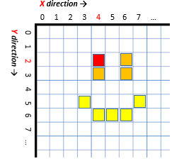
Coordinates

Slide 7


Stroke vs. Fill
context.fillStyle = "red";
context.fillRectangle(10, 10, 50, 50);
context.strokeStyle = "blue"; context.strokeRect(10, 10, 50, 50);
context.fillStyle = "red"; context.strokeStyle = "blue"; context.fillRect(10, 10, 50, 50); context.strokeRect(10, 10, 50, 50);

